Slide 1
Tailoress…
Created by;
200403001168:- Jani Mansi Riteshkumar.
200403001180:-Panchal Vaibhavi Bharatbhai.
200403001054:- Prajapati Dhruvi Kirtikumar.

Slide 2
Introduction
Tailoress applications are computer programs that allow users to create custom-made garment.it is a great way to get the perfect fit with minimal effort. With the help of these applications, users can create unique pieces of clothing that fit their exact body measurements. these applications provide users with a wide range of Fabrics,Colours and pattern to choose form. Additionally, users can also customize the design of their garments with help of advanced tools and techniques. This makes it easy for users to create unique pieces of clothing that meet their individual needs. Tailoress application with mean stack technology over traditional web development techniques.it powerful tool that allows us to create applications quickly and easily access and modify the code freely. The technology is also highly scalable, making it easy to adjust the application to fit the needs of users. additionally, mean stack technology is open source. First we must create the application’s front-end interface, which is the user-facing part of the application. Then, the back-end of the application must be created, which is responsible for the application’s data storage and processing. finally, the application must be tested and deployed to ensure that it works an intendent.

Slide 3
Mean stack technology
E and A of MEAN (express and angular) are two of the most popular and well-supported Java script frameworks for back-end and front-end development, respectively. Express makes routing and managing HTTP requests and responses super easy, and includes great support for middleware to handle JSON endpoints and form posts. Angular is a powerful tool for building dynamic HTML pages that communicate with a back-end server. Whether you’re building a high-throughput API, a simple web application, or a microservice, MEAN is the ideal stack for building node.js applications. All of the MEAN stack components are open source in nature and therefore allow a generous, free-of-charge opportunity for developers.

Slide 4
Objectives
Most people prefer custom-made clothes. The issue is that these individuals lack access to a skilled tailor in their vicinity. Finding a reputable tailor shop is like discovering a lost penny in a river. We design an on-demand Sewing Online app with convenient service- providing capabilities, such as taking measures according to the booked appointment.

Slide 5
Benefits
Tailoress applications provide users with a number of benefits. Firstly, they allow users to create garments that fit their exact body measurements, providing them with a perfect fit. Additionally, these applications also provide users with a wide range of fabrics, colors, and patterns to choose from.
Moreover, with the help of these applications, users can also customize the design of their garments. This makes it easy for users to create unique pieces of clothing that meet their individual needs. Finally, these applications also save users time and money, as they can create garments without having to go to a tailor

Slide 6
Applications
Tailoress applications can be used for a number of different purposes. Firstly, they can be used to create custom-made garments for individuals. Additionally, these applications can also be used to create garments for businesses, such as uniforms for employees. Furthermore, these applications can also be used to create garments for special occasions, such as weddings.
Moreover, these applications can also be used to create garments for theatrical productions. Finally, these applications can also be used to create garments for fashion shows and other events. This makes tailoring applications a versatile tool for creating custom-made garments.

Slide 7
Hardware & Software Requirements
Hardware Requirement
Laptop
Software Requirement
Visual Studio Code
Angular(Frontend)
Node(Backend)
Mongoose(Backend)

Slide 8
Module:-1
Tailoress measurement
Login
Customer Entry
Manage Customer’s Measurements
Mange Category : Suit, Jacket, Formal Shirt, Trouser
Manage Units : size measurement
Invoice
Receipt print &download

Slide 9
Module:-2
Product management system.
User can see all the available products.
choose products base different category.
Select product like Fabric, Cotton.

Slide 10
Why we need new system?
As per client requirement they need such applications for their company With some
additional features like:-
Login.
Customer Entry.
Manage Customer’s Measurements.
Special Features.

Slide 11
E-R Diagram
ER Diagram stands for Entity Relationship Diagram, also known as ERD is a diagram that displays the relationship of entity sets stored in a database. In other words, ER diagrams help to explain the logical structure of databases. ER diagrams are created based on three basic concepts: entities, attributes and relationships.
ER Diagrams contain different symbols that use rectangles to represent entities, ovals to define attributes and diamond shapes to represent relationships.
ER diagram looks very similar to the flowchart.

Slide 12
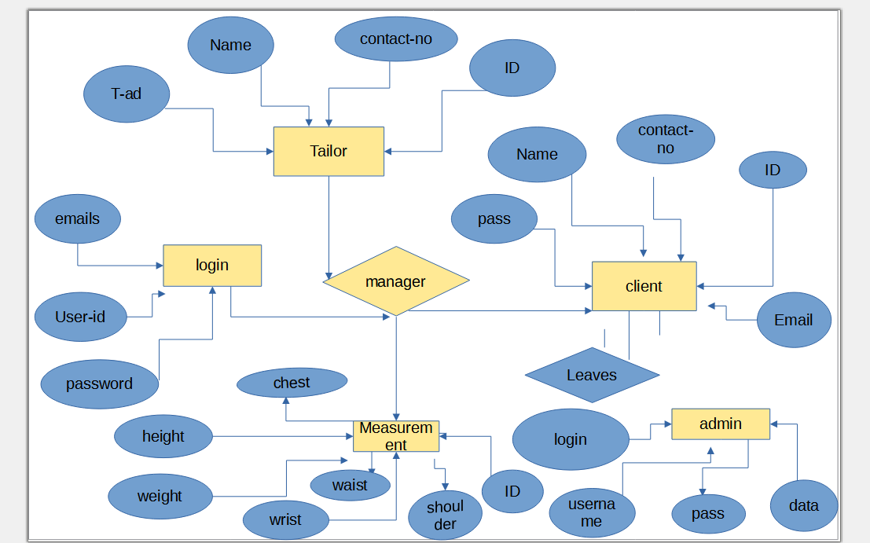

Slide 13
Sequence Diagram
The sequence diagram represents the flow of messages in the system and is also termed as an event diagram. It helps in envisioning several dynamic scenarios. It portrays the communication between any two lifelines as a time-ordered sequence of events, such that these lifelines took part at the run time. In UML, the lifeline is represented by a vertical bar, whereas the message flow is represented by a vertical dotted line that extends across the bottom of the page. It incorporates the iterations as well as branching.

Slide 14
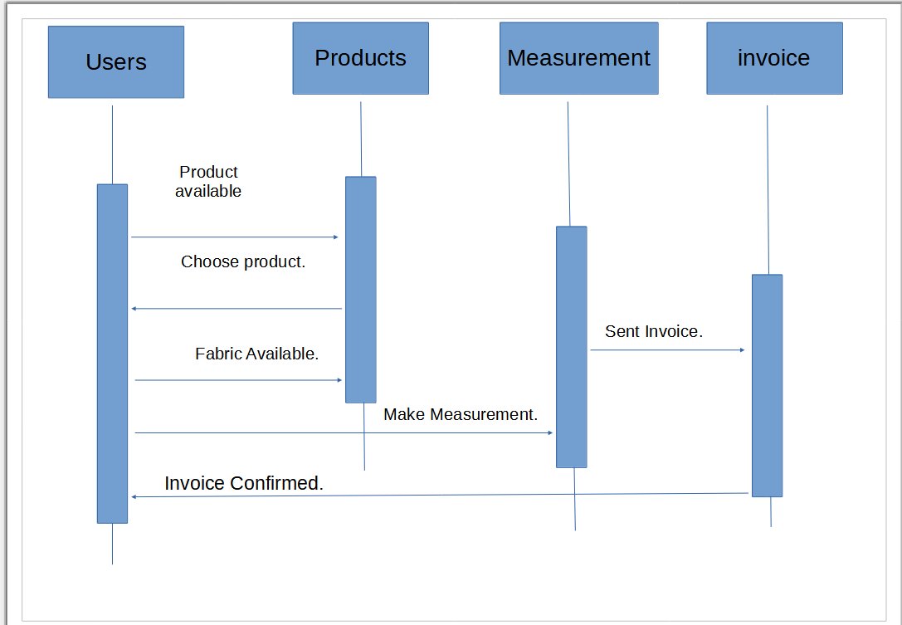

Slide 15
DFD diagram
Data Flow Data flow describes the information transferring between different parts of the systems. The arrow symbol is the symbol of data flow. A relatable name should be given to the flow to determine the information which is being moved. Data flow also represents material along with information that is being moved. Material shifts are modeled in systems that are not merely informative. A given flow should only transfer a single type of information. The direction of flow is represented by the arrow which can also be bi-directional.

Slide 16
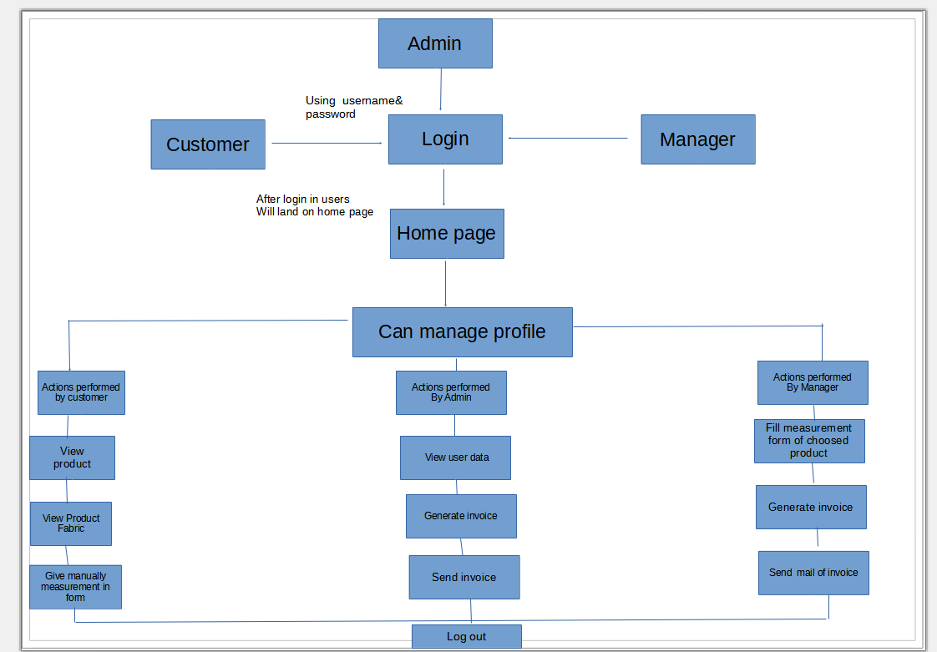

Slide 17
Benefit’s of MEAN stack
MEAN applications can be used in many ways with a cross-platform write-once approach. While MEAN is particularly suited to real-time applications, particularly those running natively in the cloud and single-page (dynamic) web applications built in Angular.js.
it can be used for other use cases such as:
Workflow management tools
News aggregation sites
To-do and calendar applications
Interactive forums
It is also useful for enterprise application

Slide 18
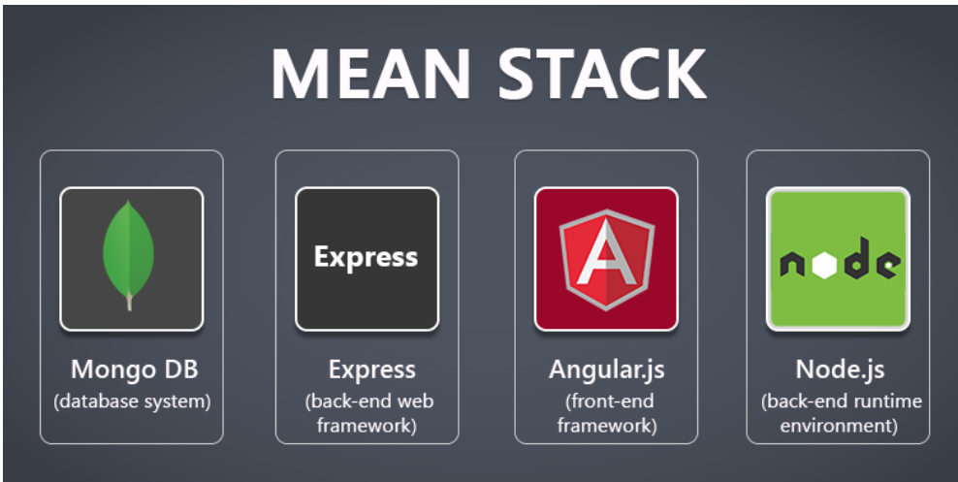

Slide 19
Process of MEAN Stack
The scenario described above involves a user accessing a tailoress store application. When the user enters the URL, JavaScript will be run and will hit the router of the front-end server, which is the AppRoutingModule. The App Routing Module will call the Tailoress Component, which will load fetch User input as its dependency injection.
Fetch user input will then create an HTTP request to the back-end server that has a router, controller, and model to process the request and query the database server.
The database server processes the query, and with the back-end server waiting, will grab the data and sent it back to the front-end server as a JSON response.
The front-end will now have the data and the template view to show to the user.

Slide 20
Scope of Tailoress
As a tailoress, your duties include constructing,modifying,altering and repairing garments for our customer. You should also help customers in selecting the type of material as well as the design for the clothing.

Slide 21
Thank you!!!

